Slide 1
Key Events

Slide 2


11.16 Key-Event Handling
KeyListener interface
  For handling KeyEvents
  Declares methods keyPressed, keyReleased and keyTyped

Slide 3
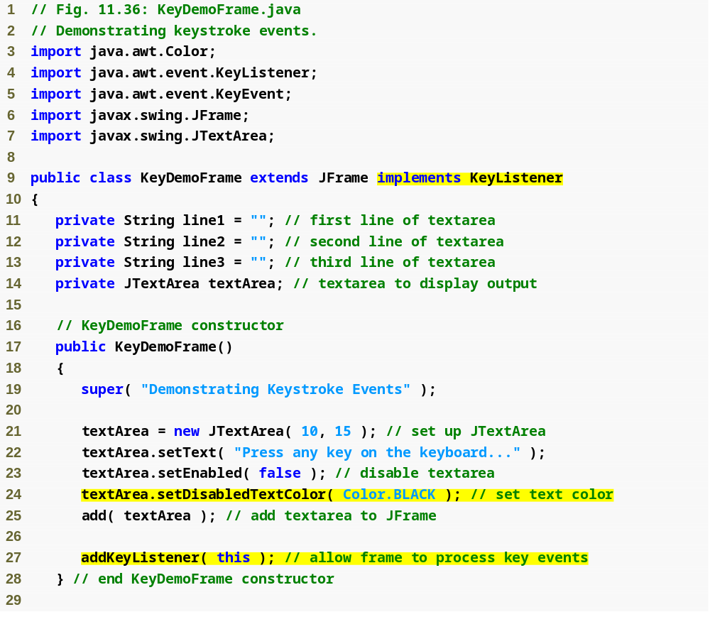
Outline
KeyDemoFrame
.java
(1 of 3)
Implement KeyListener interface
Set background color
Register application as event handler for itself

Slide 4
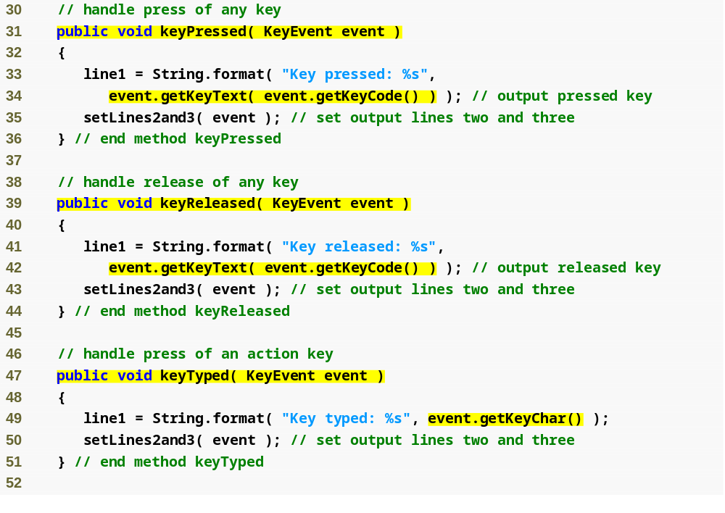
Outline
Declare keyPressed method
Get code of pressed key
KeyDemoFrame
.java
(2 of 3)
Declare keyReleased method
Get code of released key
Declare keyTyped method
Get character typed

Slide 5
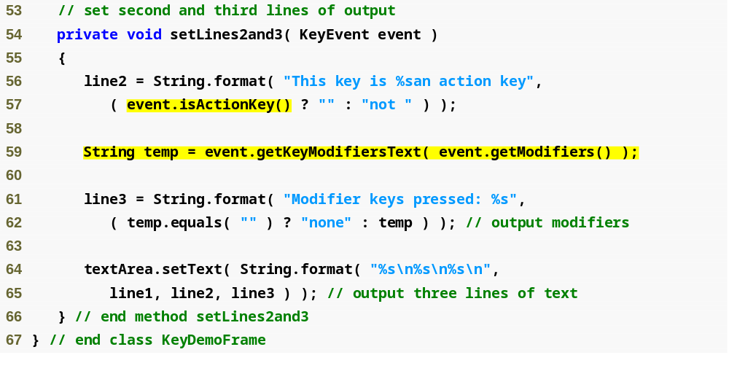
Outline
Test if it was an action key
KeyDemoFrame
.java
(3 of 3)
Determine any modifiers pressed

Slide 6
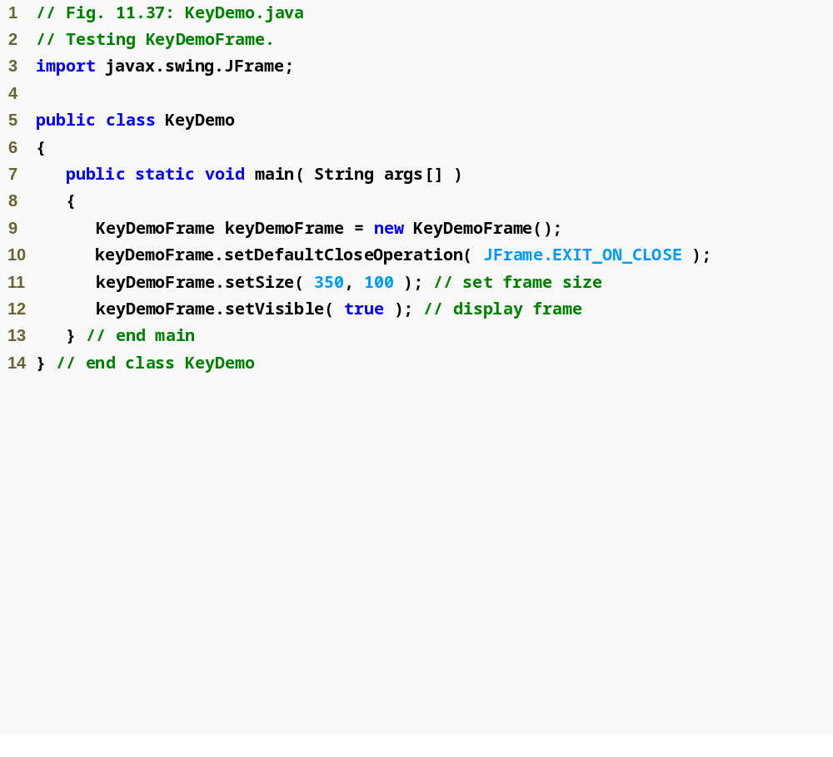
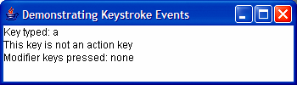
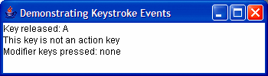
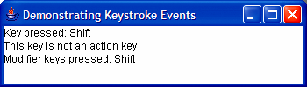

Outline
KeyDemo.java
(1 of 2)

Slide 7
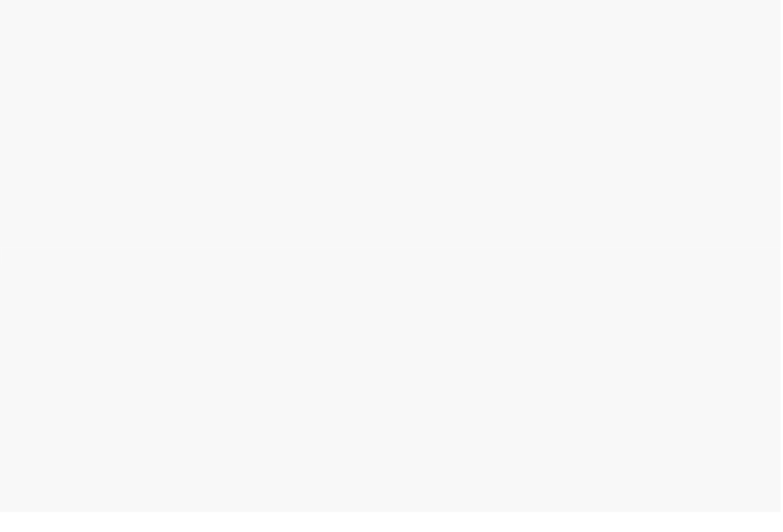
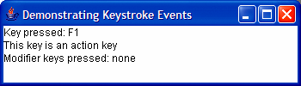

Outline
KeyDemo.java
(1 of 2)

Slide 8
Mouse Events

Slide 9
Mouse Event Handling
Mouse events
  Create a MouseEvent object
  Handled by MouseListeners and MouseMotionListeners
  MouseInputListener combines the two interfaces
  Interface MouseWheelListener declares method mouseWheelMoved to handle MouseWheelEvents

Slide 10
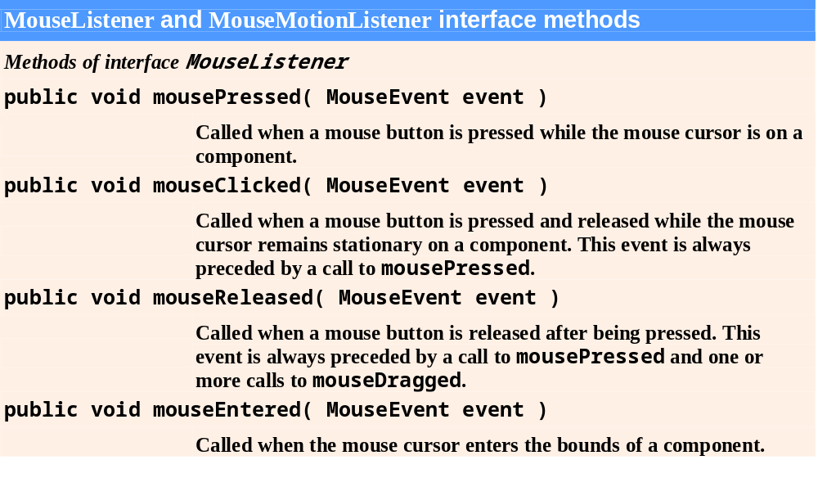
Fig. 11.27 | MouseListener and MouseMotionListener interface methods. (Part 1 of 2.)

Slide 11
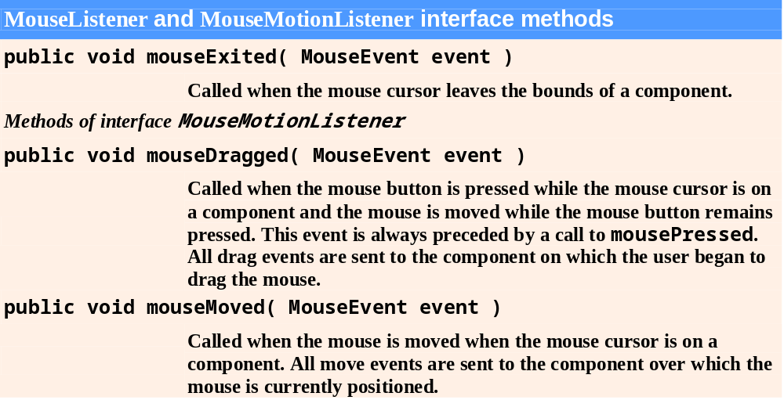
Fig. 11.27 | MouseListener and MouseMotionListener interface methods. (Part 2 of 2.)

Slide 12
Look-and-Feel Observation 11.12
Method calls to mouseDragged and mouseReleased are sent to the MouseMotionListener for the Component on which a mouse drag operation started. Similarly, the mouseReleased method call at the end of a drag operation is sent to the MouseListener for the Component on which the drag operation started.

Slide 13
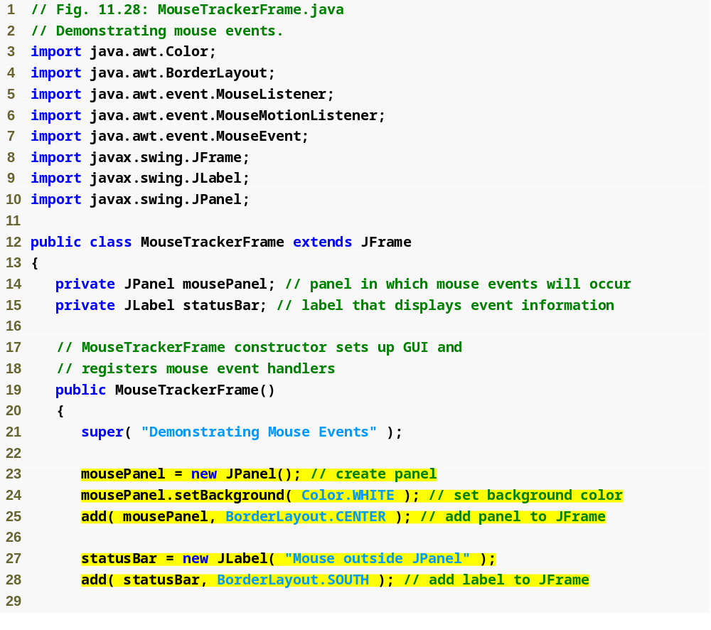
Outline
MouseTracker
Frame.java
(1 of 4)
Create JPanel to capture mouse events
Set background to white
Create JLabel and add to application

Slide 14
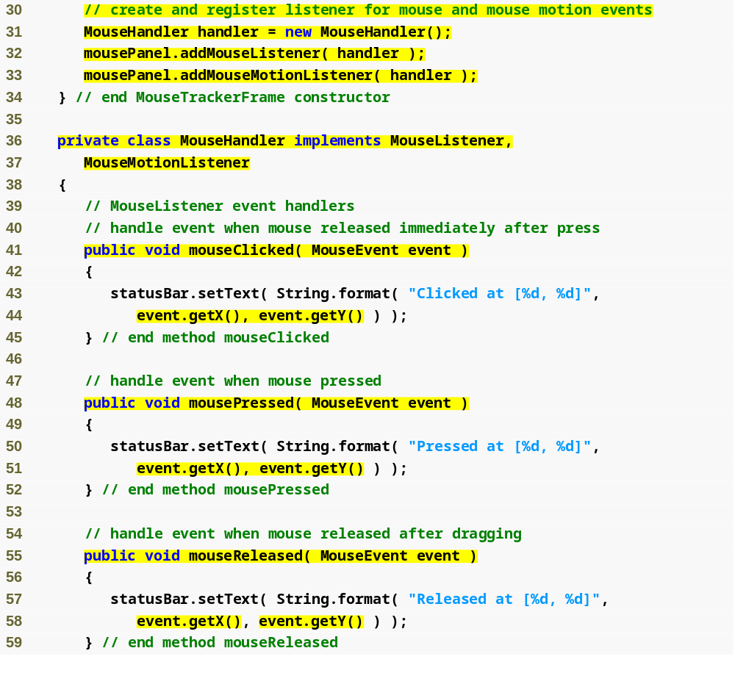
Outline
Create event handler for mouse events
Register event handler
MouseTracker
Frame.java
(2 of 4)
Implement mouse listener interfaces
Declare mouseClicked method
Find location of mouse click
Declare mousePressed method
Declare mouseReleased method

Slide 15
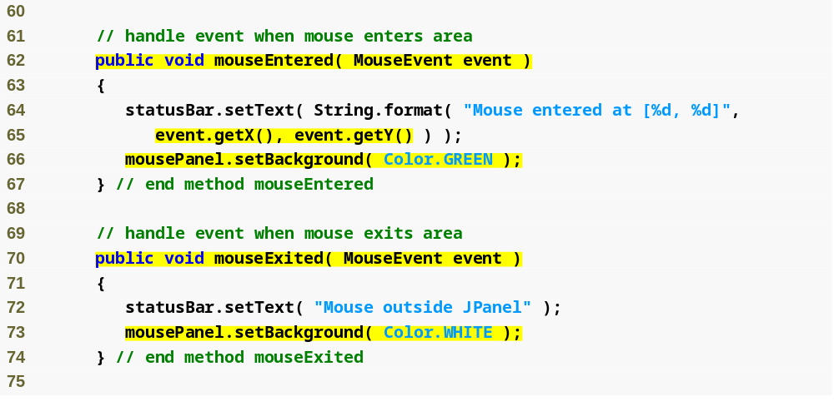
Outline
Declare mouseEntered method
MouseTracker
Frame.java
(3 of 4)
Set background of JPanel
Declare mouseExited method
Set background of JPanel

Slide 16
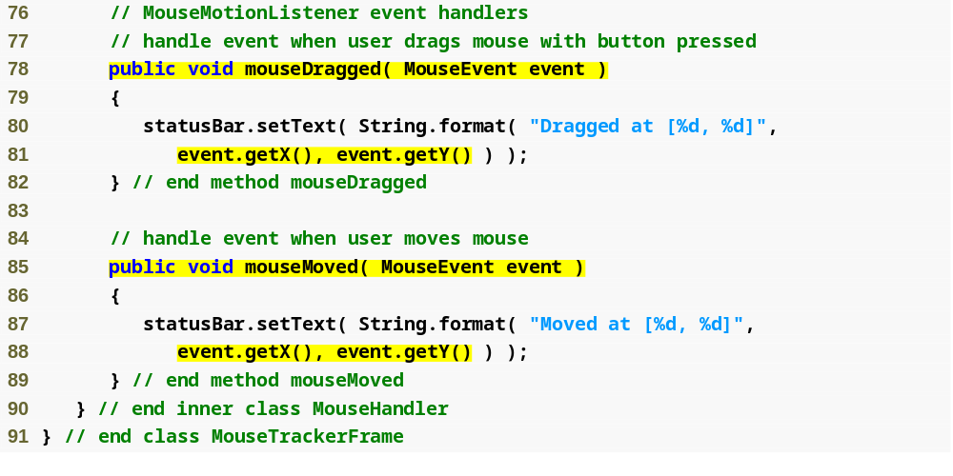
Outline
Declare mouseDragged method
MouseTracker
Frame.java
(4 of 4)
Declare mouseMoved method

Slide 17
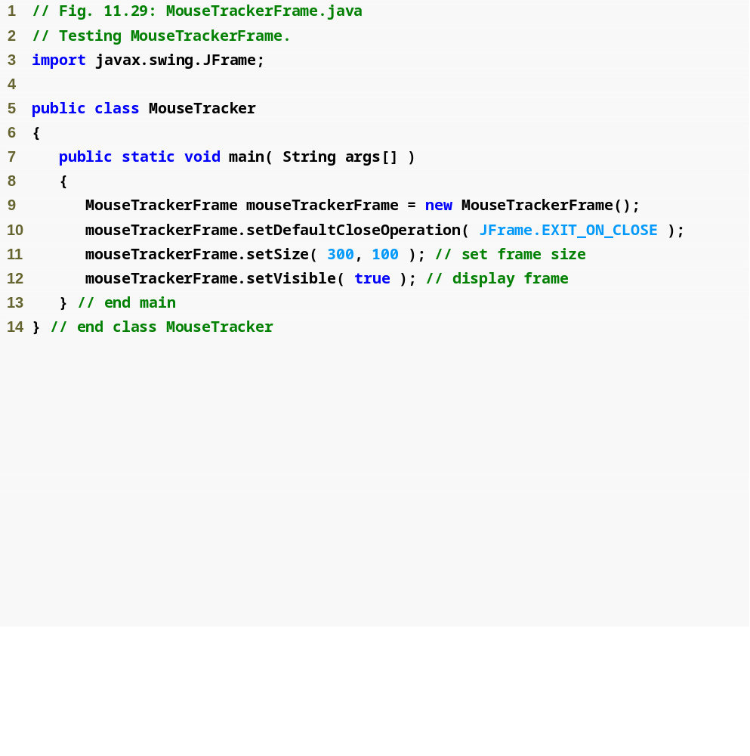
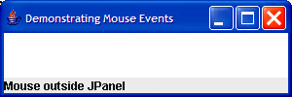
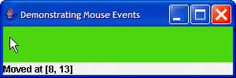
Outline
MouseTracker
Frame.java
(1 of 2)

Slide 18
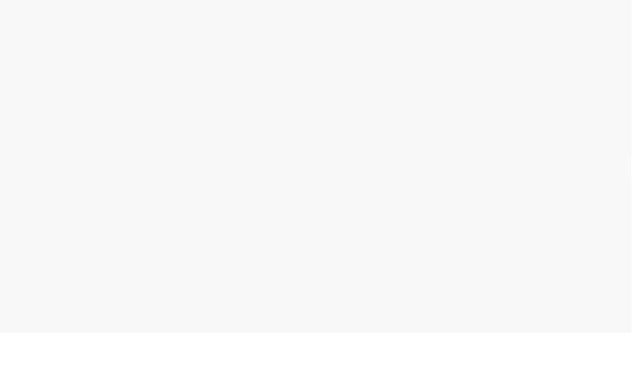
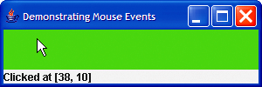
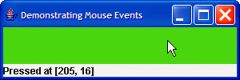
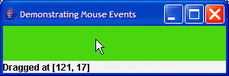
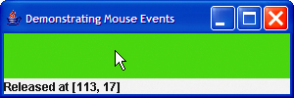
Outline
MouseTracker
Frame.java
(2 of 2)

Slide 19
11.14 Adapter Classes
Adapter class
  Implements event listener interface
  Provides default implementation for all event-handling methods

Slide 20
Software Engineering Observation 11.7
When a class implements an interface, the class has an “is a” relationship with that interface. All direct and indirect subclasses of that class inherit this interface. Thus, an object of a class that extends an event-adapter class is an object of the corresponding event-listener type (e.g., an object of a subclass of MouseAdapter is a MouseListener).

Slide 21
Extending MouseAdapter
MouseAdapter
  Adapter class for MouseListener and MouseMotionListener interfaces
  Extending class allows you to override only the methods you wish to use

Slide 22
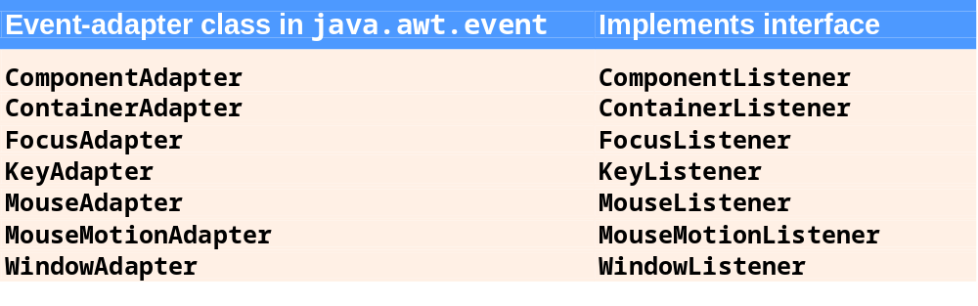
Fig. 11.30 | Event-adapter classes and the interfaces they implement in package java.awt.event.

Slide 23
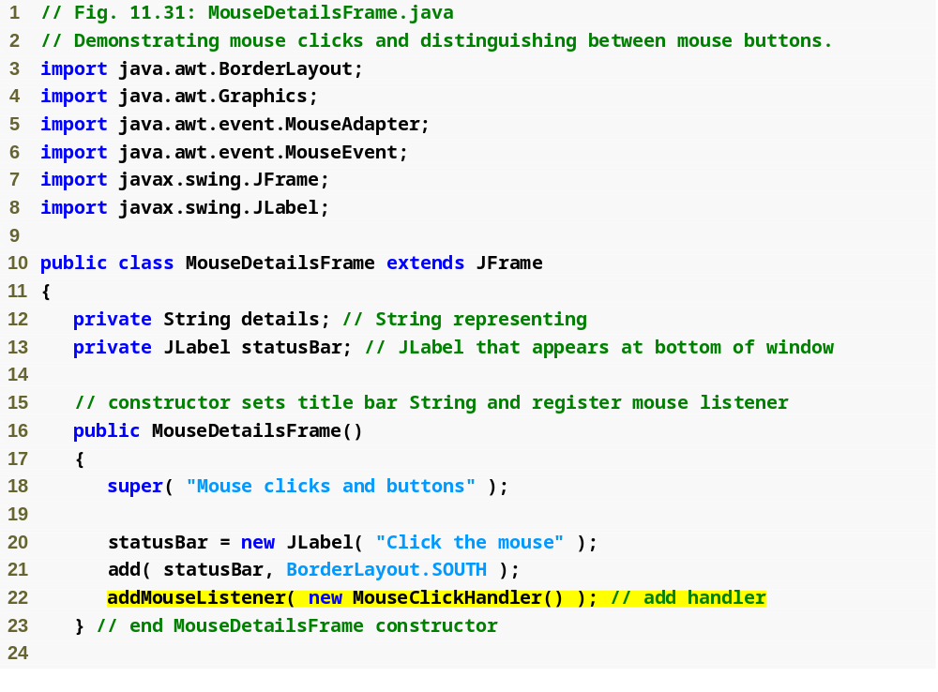
Outline
MouseDetails
Frame.java
(1 of 2)
Register event handler

Slide 24
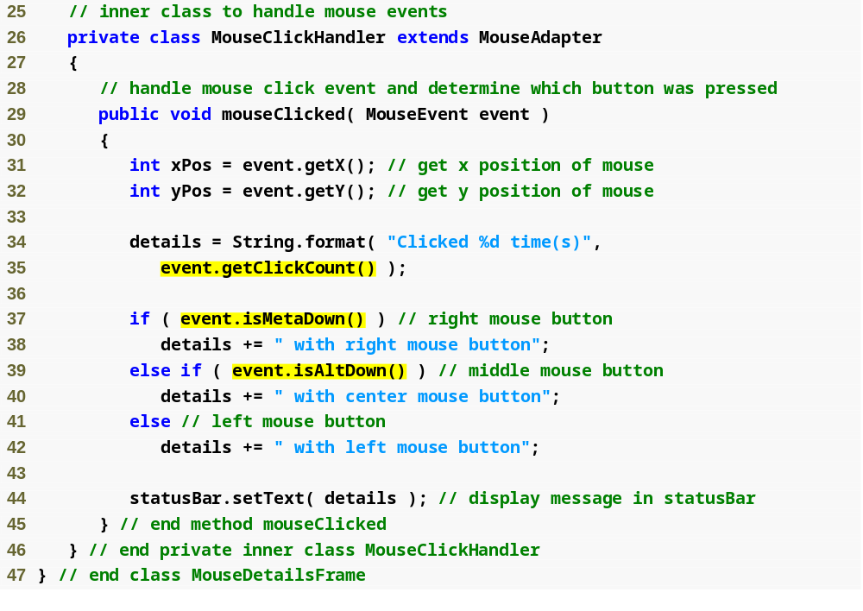
Outline
MouseDetails
Frame.java
(2 of 2)
Get number of times mouse button was clicked
Test for right mouse button
Test for middle mouse button

Slide 25
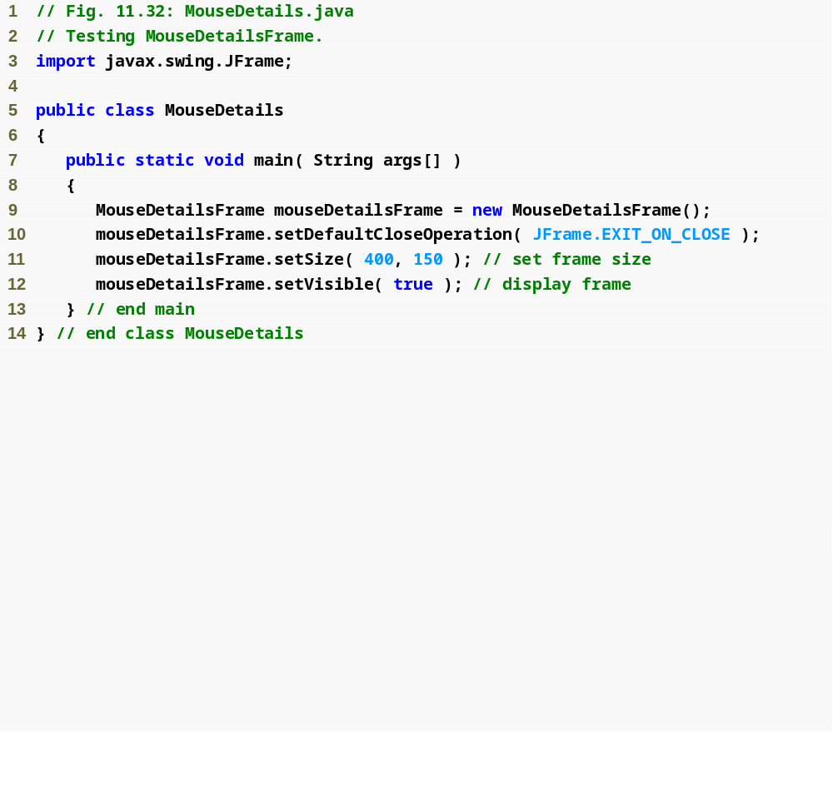
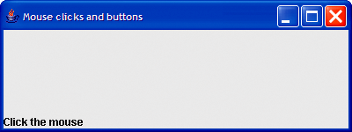
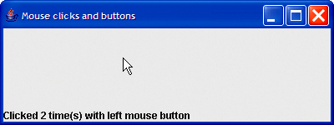
Outline
MouseDetails
.java
(1 of 2)

Slide 26
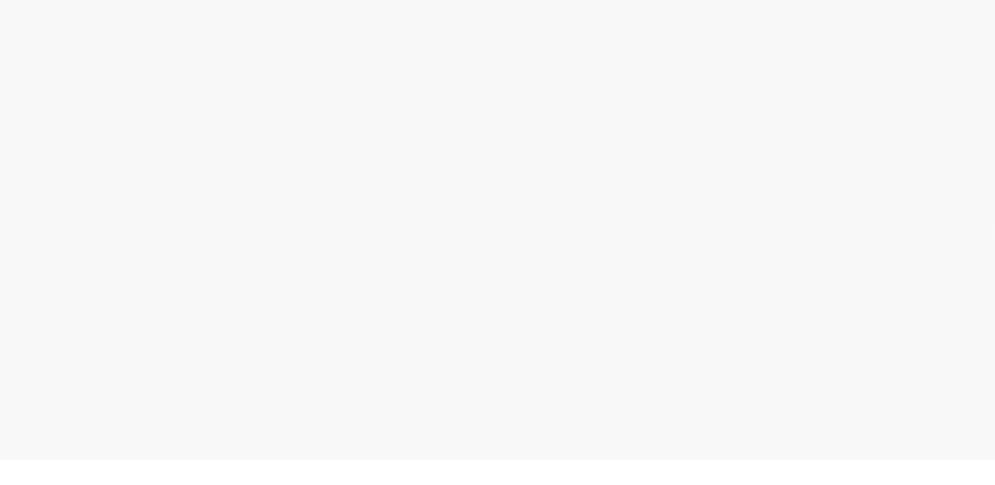
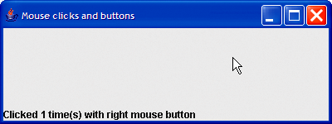
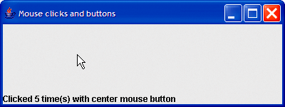
Outline
MouseDetails
.java
(2 of 2)

